Slide 1
Industrial Batch Process Using IOT
ARCHANA D
BALASUBRAMANIAM B
BHUVANESH M
SIVASUBRAMANIAN G
NIRUBASRI C

Slide 2
PROBLEM STATEMENT
The recent advancement in technology has led to the rise of automation in every sectors.
Industries are operated with the help of various PC automated systems. But there is lot of wastage in energy at industrial work environment and the real status of the installed system may be hiding through workers.
Continuous monitoring of industry appliances or machines is very much essential, but this system requires a greater number of equipment layers and requires more amount of floor space.

Slide 3
OBJECTIVE
The main objective of the project is to automate, control and monitor an industrial batch process. In this process parameters such as temperature, gas, concentration of fluids and fluid levels are used for identifying and alerting from undesirable activities in the batch process.

Slide 4
SOLUTION TO PROBLEM STATEMENT
The solution is to propose an System which can provide both controlling and monitoring via Internet.
The values that are sensed by various sensors that are installed (Ph sensor, level sensor, gas sensor, temperature sensor) in the process are monitored by Thingspeak an IoT platform.
This system allows aggregating, visualizing, and analysing live data in the cloud and the controlling of the Heater in the system is done with the help of Blynk IoT.

Slide 5
JUSTIFICATION TO OUR SOLUTION
This project gives the design of a prototype of an Industrial Batch Process system where the NodeMCU and internet of things are involved.
This gives a demonstration of how to build up a remotely controlled system that can enable the person away from the industry surroundings to control the system by and get the related data on the Internet.

Slide 6
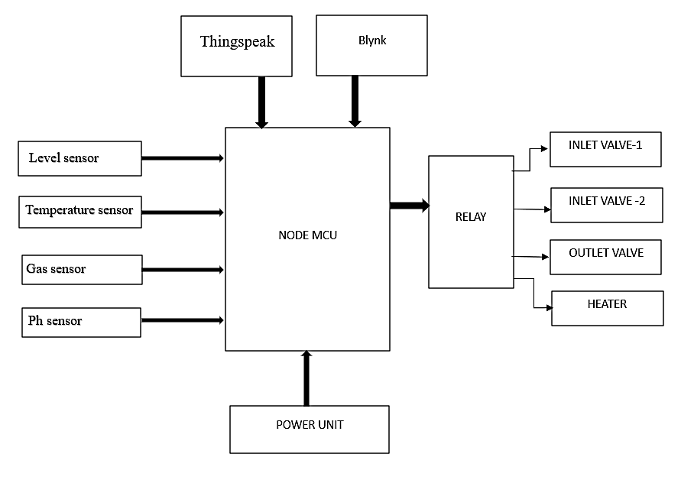
BLOCK DIAGRAM

Slide 7
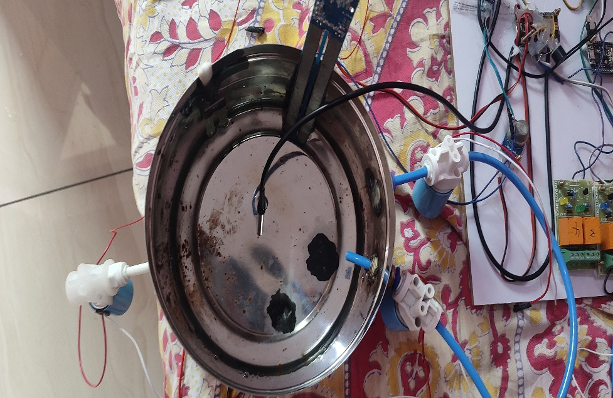
RESULT
The batch process station is shown in Figure below in which the two inlet valves and outlet valves are seen, the sensors that are used in the process can also be seen i.e., Ph sensor, level sensor, temperature sensor. The valves are actuated by the relay and the supply to the Node MCU is given via the power unit which produces a +5v DC.

Slide 8
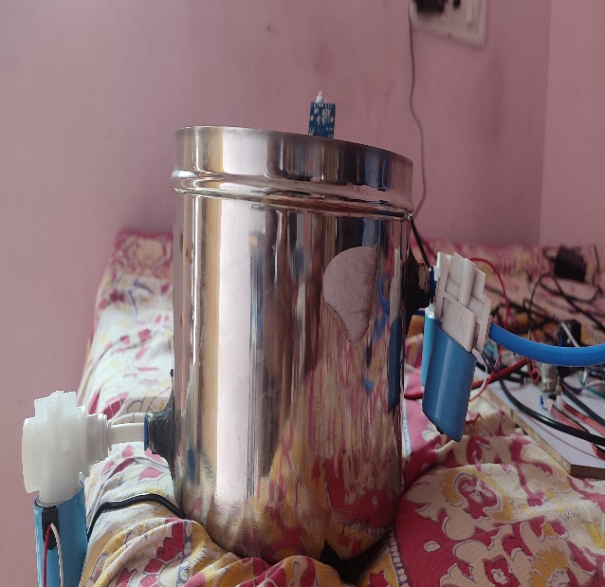
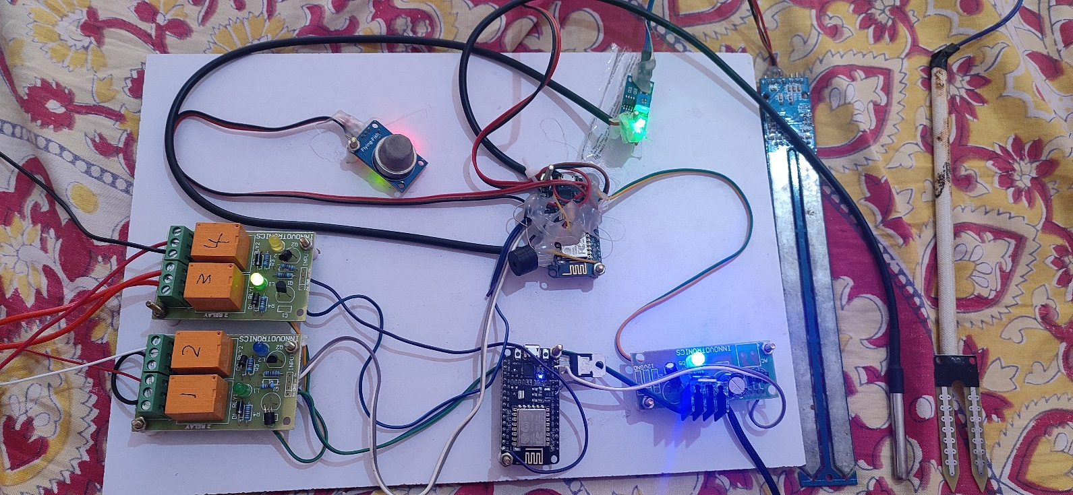
Batch Process Setup
Embedded Kit

Slide 9
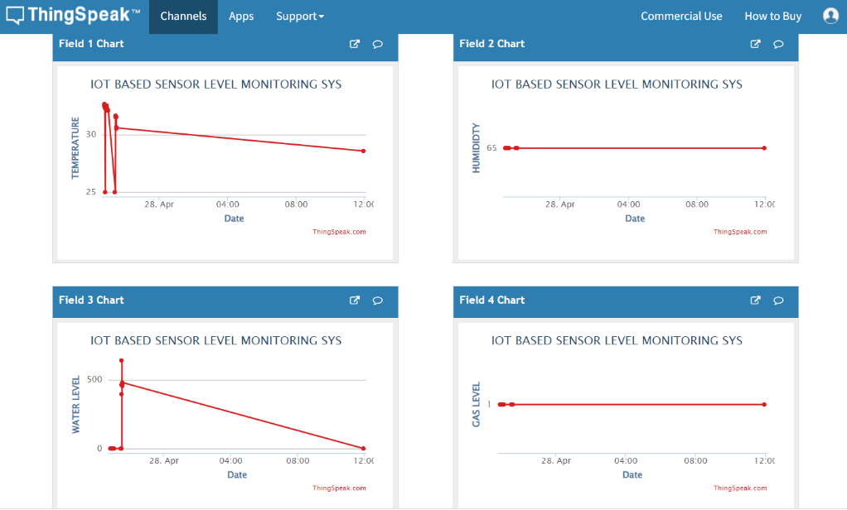
RESULTS FROM THINGSPEAK.
As soon as the kit is on the sensor values are updated in the thingspeak platform every 10 sec. This transmission of the data also depends on the network strength of the connected device.

Slide 10
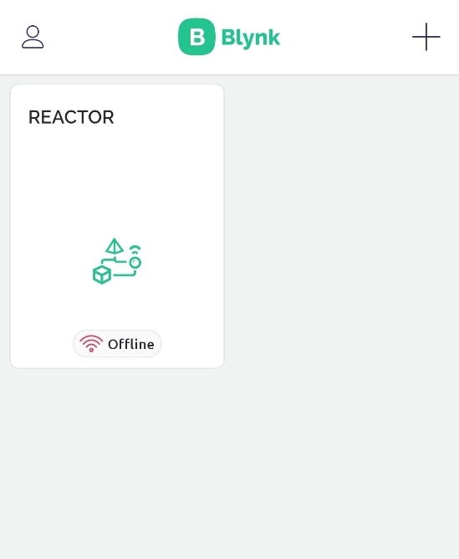
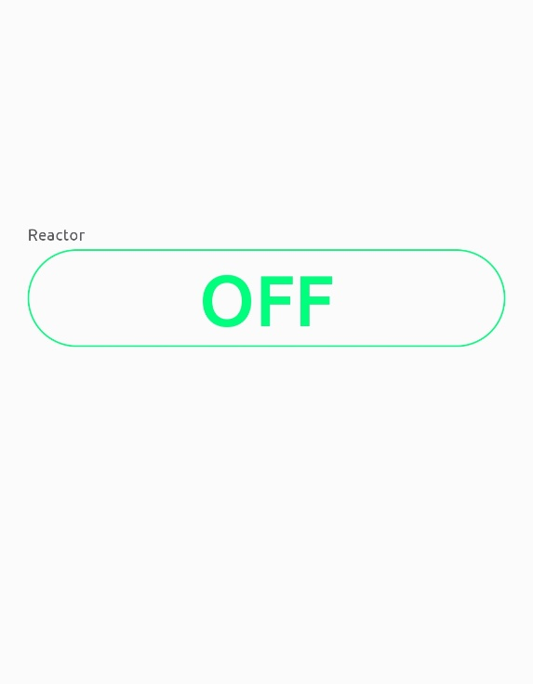
RESULTS FROM BLYNK
The control of the heater is done via blynk IoT platform to which we have created a template that turns on/off via the cloud.

Slide 11
REFERENCES
[1].H.K.Merchant,D.D.Ahire, “Industrial automation using IOT with Raspberry Pi” , International Journal of Computer Applications , Volume 168 – No.1, June 2017
[2] Thimmapuram Swati, K. Raghavendra Rao “Industrial Process Monitoring System Using Esp32” International Journal of Recent Technology and Engineering (IJRTE) ISSN: 2277-3878, Volume-7, Issue-6S4, April 2019
[3] Shrushti Panpaliya, Nita Surayawansi Nikhil S. Mundane “Industrial Monitoring and Control Applications Using IOT” International Journal of Emerging Technologies in Engineering Research (IJETER) Volume 6, Issue 1, January (2018)
[4] Himanshu kr. Singh, Ayush Srivastava, Irfanuddin “IOT Industrial Automation Using Raspberry Pi” International Journal of Engineering Research and Applications

Slide 12
THANK YOU

